Slide 1
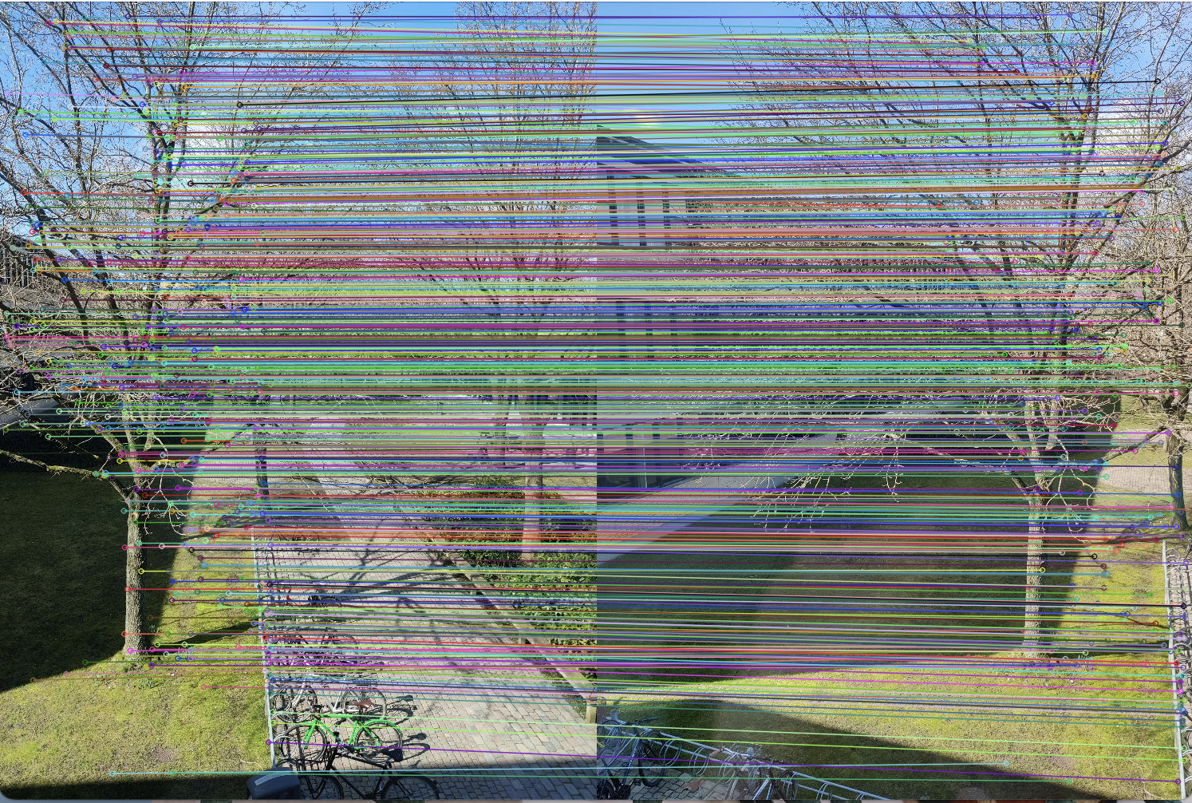
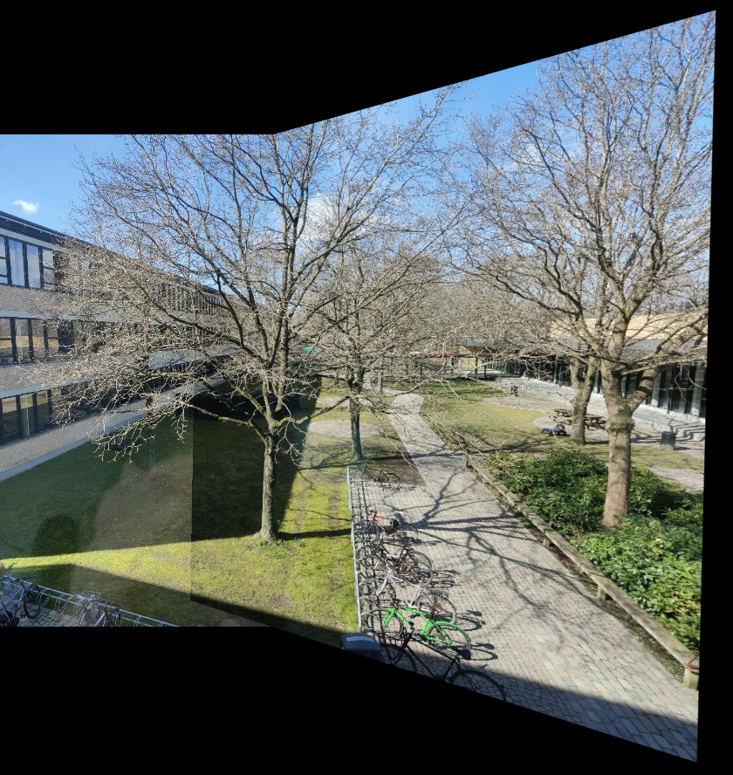
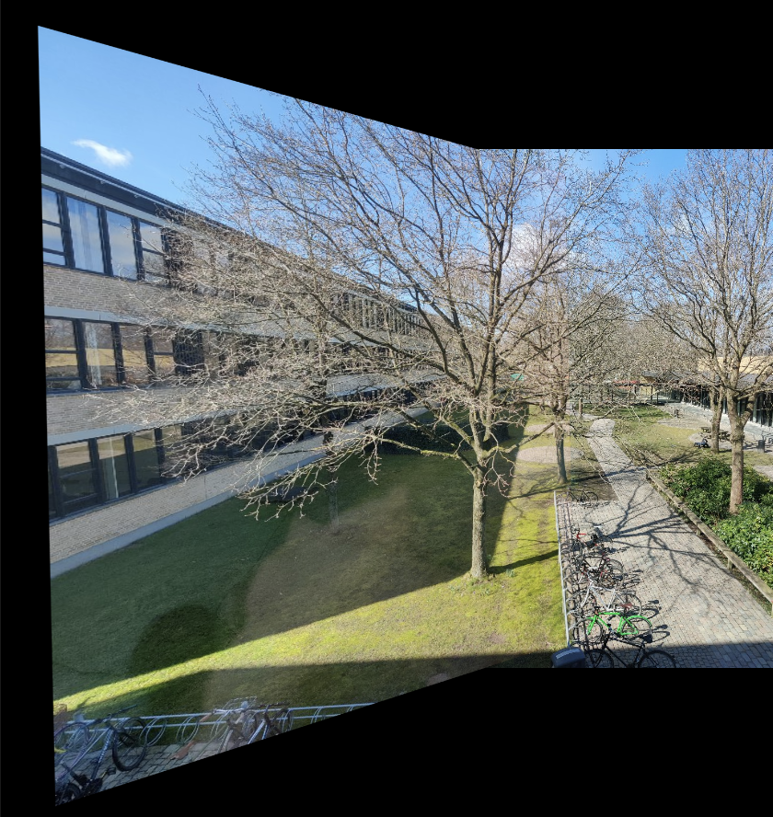
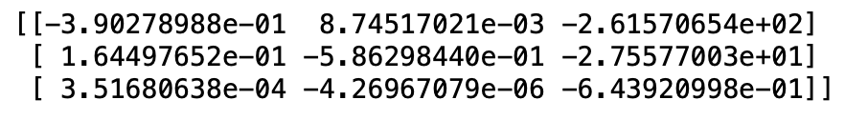
Exercise 10
Inlier Matches from Estimated Homography
Image Stitching
Estimated Homography Matrix(From P2 to P1)
Exam Presentation

